Slide 1

Session 7 – Python
Brief Intro to Machine Learning with Scikit Learn
Doug Bowman

Slide 2
Overview
Overview
Intro Example Code
Concepts and Definitions
General Model Types
Linear Models
Dataset Preparation
Evaluating Accuracy
Ensemble Methods
Tuning
Bringing it All Together – Model Selection

Slide 3
Overview
Intro Example Code
Build and run the first model built with the iris data set in ‘Machine Learning with Scikit-Learn.py’

Slide 4
Concepts and Definitions
Machine Learning
The use of a model that learns from data to increase the predictive ability of an algorithm.
Data by itself is not machine learning, since no learning can occur without assimilation of the data towards prediction.
Data that cannot increase predictive capabilities of an algorithm is not machine learning—no learning occurs in this situation.

Slide 5
Concepts and Definitions
Trainers
The mathematical equation, set of equations, and/or algorithm that is used to build a model.
Examples:
Classifiers
Regressors

Slide 6
Concepts and Definitions
Classifier
The trainers used to build models to predict outcomes for classification problems.
For problems where we are trying to categorize something.
i.e. trying to determine what kind of fruit something is.
Trying to determine what kind of animal is in a picture.
This is the scaffolding for our model.

Slide 7
Concepts and Definitions
Regressor
The trainers used to build models that predict outcomes for regression problems.
Problems were we are predicting a quantity within a range of values.
i.e. Predicting the median household income in the future.
How much thrust a new engine model will have.
This is the scaffolding for our model.

Slide 8
Concepts and Definitions
Regressor
In general, regressors predict by creating a function.
For linear regressors, the function is similar to the following:
Y_{predict} = w₁*f₁ + w₂*f₂ + w₃*f₃ + … + w_{n}*f_{n} + b + r
Y_{predict} = predicted value for a given sample
w = weights
f = feature value
n = number of features
b = intercept of linear line
r = regularization parameter
Notes:
Regularization parameter is used to adjust how the weight factors are optimized.
Different models either don’t use regularization, or use different methods for regularization.

Slide 9
Concepts and Definitions
Model
The construct that is/will be trained and filled with data.
This is what will tell us what the “answer” is.

Slide 10
Concepts and Definitions
Trainer vs Model
The trainer is the template used to create a model.
The model is what actually contains the data, where the trainer tells the model what to do with the data.
The trainer is like a class, where the model is like an object.

Slide 11
Concepts and Definitions
Experience
The incorporated data used to increase the effectiveness of the model’s predictions.

Slide 12
Concepts and Definitions
Feature
A description of a set of like-data.
This is usually represented as a column in a data table.
Examples:
Color of a fruit
Length of a fruit
Width of a fruit

Slide 13
Concepts and Definitions
Feature
Examples continued:
Past convictions when estimating if a person will commit a crime
Family members with convictions when estimating if a person will commit a crime
Convictions of local living area when estimating if a person will commit a crime

Slide 14
Concepts and Definitions
Sample
A single set of data, or a data point.
This is usually a row in a data table.

Slide 15
Concepts and Definitions
Label (Classification Problems)
The name associated with a data point (row) for classification problems.
This is generally the thing we are trying to predict.
A.k.a. target
Examples:
‘Apple’ if we are trying to predict a piece of fruit.
‘Yes/true’ if we are predicting if someone will commit a crime.

Slide 16
Concepts and Definitions
Training Data
Data that is used to build our model.
Data that is not used to test the accuracy of our model.

Slide 17
Concepts and Definitions
Test Data
Data that is used to test the accuracy of a trained model.
Separate from training data.

Slide 18
Concepts and Definitions
Overfitting
Training a model so closely to training data that it does not model test data/other data as accurately.
Usually indicated by a high accuracy on the training data, and an unreasonably low accuracy on the test data.
The model will not be able to extrapolate or interpolate well.

Slide 19
Concepts and Definitions
Overfitting
Possible Causes:
Test data that is not sufficiently representative of the entire data spectrum.
Tuning parameters adjusted too tightly to test data
Extrapolating when only interpolating is relevant

Slide 20
Concepts and Definitions
Underfitting
Training model not tight enough to test data and training data.
Indicated by unreasonably low training and test data accuracy.
Possible Causes:
Tuning parameters not tuned enough.
Incorrect features, or insufficient number of features, selected.

Slide 21
Concepts and Definitions
Decision Boundary
The boundary between different categories in a classification problem.
This is generated by the model.

Slide 22
General Model Types
Supervised
Machine learning model is given a set of data to build experience with.
Data is given with features, and an algorithm is given to the model on how to best categorize and group the data.

Slide 23
General Model Types
Unsupervised
The model determines the data for itself, and builds the model accordingly.
Features and grouping data is done by the algorithm.

Slide 24
General Model Types
Reinforcement
The algorithm “learns” from making mistakes.
There must be some sort of way to tell the algorithm when it makes a correction in the right direction, and a way to tell the algorithm a correction was made in the wrong direction.
Initially, the model built is very inaccurate, but gets better with time.

Slide 25
General Model Types
This part of the Python course will focus on supervised learning, as this is all I know.

Slide 26
General Workflow
Get data
Build model
Evaluate predictive capabilities
Rebuild model, if needed
Predict real-world outcomes

Slide 27
General Workflow
Get Data
Get set of data about what we wish to predict.
Include the labels.

Slide 28
General Workflow
Build Model
Select an appropriate classifier.
The model should be trained with a majority of the data we gathered, say with 75% of the data.
The other 25% can be used to test how good our model can predict.

Slide 29
General Workflow
Evaluate Predictive Capabilities
The model needs to be evaluated for acceptable predictive capabilities to ensure our predictions will have a high degree of correctness.
This is usually done using a sequestered set of data we use for testing.

Slide 30
General Workflow
Evaluate Predictive Capabilities
There is no such thing as 100% accuracy unless you have toy data, or a completely defined system that does not need machine learning.
If we get 100% accuracy, and the above are not true, we have most likely over-fitted our model, possibly by using training data as test data.
Leads to inaccurate predictions on new data without known labels

Slide 31
General Workflow
Evaluate Predictive Capabilities
Accuracy is not the only way to measure the predictive capabilities of a model.

Slide 32
General Workflow
Rebuild Model
If the model isn’t suitable enough, we rebuild the model with more/better data, more tuned parameters, or using a different trainer.

Slide 33
General Workflow
Predict real-world outcomes
Once we are happy with the predictive capability of our model, the model can be used to predict real-world outcomes that are unknown.

Slide 34
Linear Models
List of some types we will Cover
Linear Classifiers
K-Nearest Neighbors
Decision Tree
Logistic Regression
Misleading name
Support Vector Classifier

Slide 35
Linear Models
List of some types we will Cover
Linear Regressors
K-Nearest Neighbors
Linear Regression
Ridge Regression
LASSO Regression
Decision Tree
Forest
Gradient-Boosted Forest

Slide 36
Linear Models
Models differ in:
How they create a decision boundary
How they model accuracy
Tuning/regularization they use

Slide 37
Linear Models - Classifiers
Classifiers
Tries to predict a specific thing.
Is either right or wrong for each prediction.
Examples
Predicting a type of fruit.
Predicting a type of animal.
Predicting a breed of dog.

Slide 38
Linear Models - Classifiers
K-Nearest Neighbors
Predicts outcome by finding the closest matching data point neighbor(s) to the target point.
When multiple neighbors are used, the classification with the most neighbors is what the target point is classified as.

Slide 39
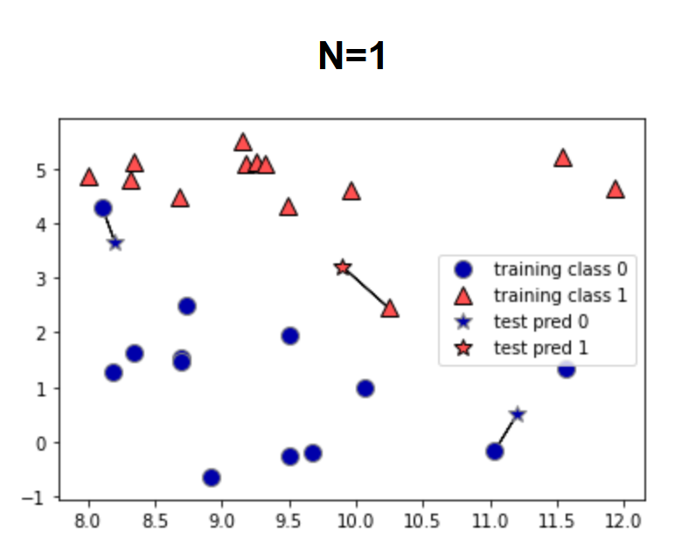
Linear Models - Classifiers
K-Nearest Neighbors
Graphs below show decision, generated in source (1). The stars are the test data, and the model is predicting whether they are blue or red.

Slide 40
Linear Models - Classifiers
In-Class Exercise
Run the classifier example with k-nearest neighbors and optimize based on number of neighbors.
Use the .score() return value as your accuracy metric.

Slide 41
Linear Models - Classifiers
Decision Tree
Builds a series of if-statements to classify test points.
Boundaries around classifications are built based on the data.
The number of if statement groups, or boundaries created, is known as the depth.

Slide 42
Linear Models - Classifiers
Decision Tree
See file “./Session 7 – Python/Instructional Material/Class Examples/Scikit-Learn/decision_tree_graph.html“ for a representation of how the decision tree classifies from data.
Generated from iris data set
Code can be found in class example code under the decision tree section

Slide 43
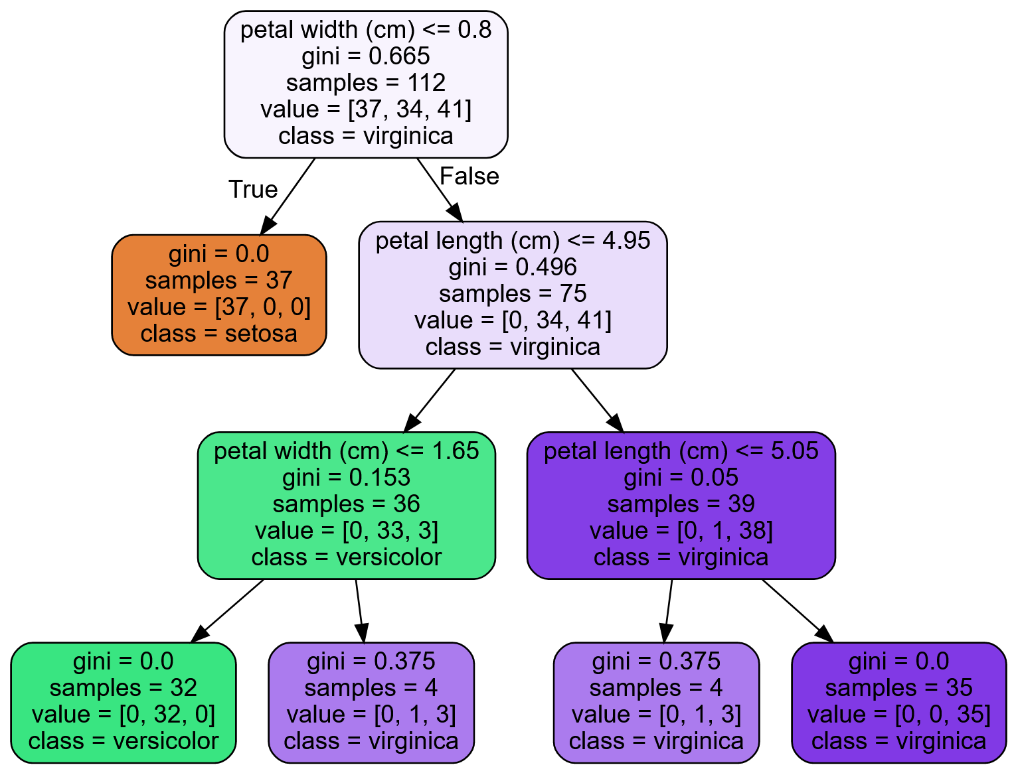
Linear Models - Classifiers
Decision Tree

Slide 44
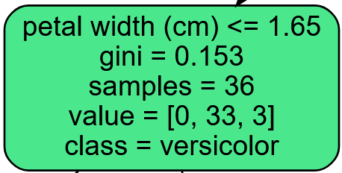
Linear Models - Classifiers
Decision Tree
Attributes
First line is the decision criteria for the children notes of the node the condition appears in.

Slide 45
Linear Models - Classifiers
Decision Tree
Attributes
Gini – A measure of the impurity of the node. 0 means all predictions are the same class, 1 means an infinite number of samples are classified in an infinite number of labels.

Slide 46
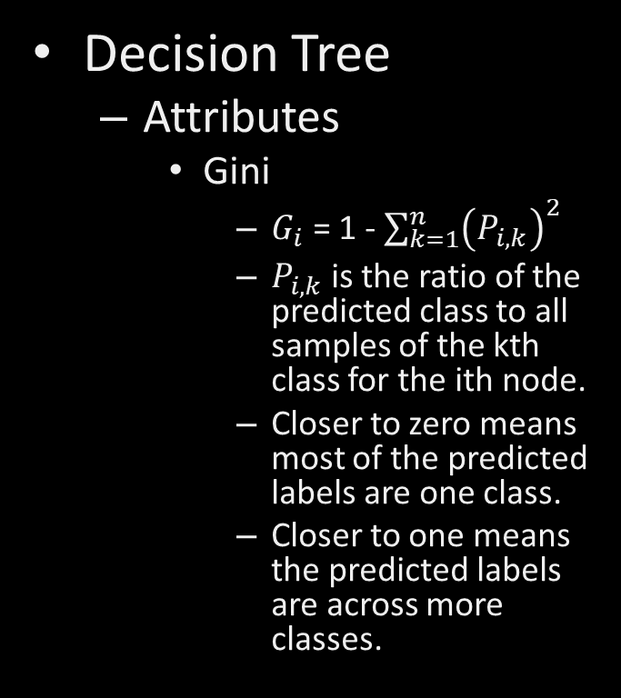
Linear Models - Classifiers
Decision Tree
Attributes
Gini
$G_{i}$ = 1 - $\sum_{k=1}^{n}{{\left(P_{i,k}\right)}^{2}}$
$P_{i,k}$ is the ratio of the predicted class to all samples of the kth class for the ith node.
Closer to zero means most of the predicted labels are one class.
Closer to one means the predicted labels are across more classes.

Slide 47
Linear Models - Classifiers
Decision Tree
Attributes
Gini
The gini score is used in a cost function to determine which feature is used to create the decision boundary/condition for each node.

Slide 48
Linear Models - Classifiers
Decision Tree
Attributes
Samples – The number of training sets used to predict the current node.
Value – The predicted classes with the given samples. This is in the order of the dataset label names.

Slide 49
Linear Models - Classifiers
Decision Tree
Attributes
Class – The predicted label of this node.

Slide 50
Linear Models - Classifiers
Decision Tree
Tends to overfit the data.
Can control this (regularize) by modifying the following parameters:
max_depth
max_leaf_nodes
max_features
min_samples_split
min_samples_leaf
min_weight_fraction_leaf
Notes:
max_depth – The maximum number of node levels to generate.
max_leaf_nodes – The maximum number of leaves that can occur in the tree.
max_features – Maximum number of features that are evaluated for splitting each node.
min_samples_split – Minimum number of samples a node must have before it can split into another depth.
min_samples_leaf – The minimum number of samples a leaf node must have to exist.
min_weight_fraction_leaf – Same as min_samples_leaf, but uses a weighted fraction instead of sample count.

Slide 51
Linear Models - Classifiers
Decision Tree
Sensitive to data
Removing/adding one data point can drastically change the decision boundaries.
Notes:
max_depth – The maximum number of node levels to generate.
max_leaf_nodes – The maximum number of leaves that can occur in the tree.
max_features – Maximum number of features that are evaluated for splitting each node.
min_samples_split – Minimum number of samples a node must have before it can split into another depth.
min_samples_leaf – The minimum number of samples a leaf node must have to exist.
min_weight_fraction_leaf – Same as min_samples_leaf, but uses a weighted fraction instead of sample count.

Slide 52
Linear Models - Classifiers
Decision Tree
Sensitive to data orientation
This applies more for regression.
Boundaries for decision trees are orthogonal (i.e. they are vertical or lateral, but not angled).
Rotating the data points on a graph can drastically change the decision boundaries.
Notes:
max_depth – The maximum number of node levels to generate.
max_leaf_nodes – The maximum number of leaves that can occur in the tree.
max_features – Maximum number of features that are evaluated for splitting each node.
min_samples_split – Minimum number of samples a node must have before it can split into another depth.
min_samples_leaf – The minimum number of samples a leaf node must have to exist.
min_weight_fraction_leaf – Same as min_samples_leaf, but uses a weighted fraction instead of sample count.

Slide 53

Linear Models - Classifiers
In-Class Exercise
Run the decision tree classifier example. Play with the depth to build accuracy, using at least 1-6 depths. Does accuracy continue to increase with depth? Why or why not?

Slide 54
Linear Models - Classifiers
Logistic Regression
Used for classification, even though the name has “regression” in it.
Works similar to other linear regressors, using a linear equation to generate decision boundaries/predict the label of the data point.

Slide 55
Linear Models - Classifiers
Logistic Regression
Estimates probability that a sample belongs to a classification or not.
If the probability is over 50%, then the sample is the label.
Since this trainer can only tell if the sample either is the label or not, this trainer can only be used for binary classification.

Slide 56
Linear Models - Classifiers
Logistic Regression
Uses regularization parameter c
Logistic regression defaults to using L2 regularization, but L1 can be chosen.
More will be discussed on regularization in the following section.

Slide 57
Linear Models - Classifiers
Logistic Regression
High c value
Less regularization
Model tries to fit training set more closely
Each feature is stressed in the weighting

Slide 58
Linear Models - Classifiers
Logistic Regression
Low c value
More regularization
Each weight is brought closer to zero, which minimizes the importance of each individual feature on the overall label prediction.
Model stresses generalization, and adjusts to hit the majority of points more than each one
Too much regularization can cause the model to miss points that are close to both categories.

Slide 59
Linear Models - Classifiers
In-class Example
Logistic Regression

Slide 60
Linear Models - Classifiers
In-Class Exercise
Optimize c for logistic regression.

Slide 61
Linear Models - Classifiers
Regularization
Trainers can use either a cost function to determine the weights of each feature, or a utility function.
Cost functions should be minimized to determine weights.
Utility functions should be maximized to determine weights.
For this class, we will be using cost functions, such as Mean Squared Error or Ordinary Least Squares

Slide 62
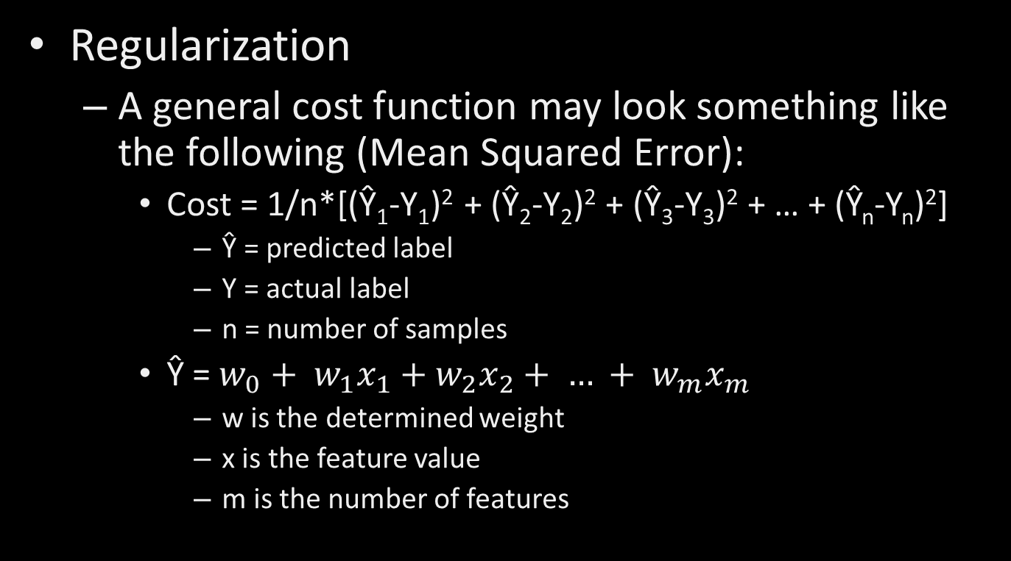
Linear Models - Classifiers
Regularization
A general cost function may look something like the following (Mean Squared Error):
Cost = 1/n*[(Ŷ₁-Y₁)² + (Ŷ₂-Y₂)² + (Ŷ₃-Y₃)² + … + (Ŷ_{n}-Y_{n})²]
Ŷ = predicted label
Y = actual label
n = number of samples
$\text{Ŷ} \text{= }w_{0}+ w_{1}x_{1}+w_{2}x_{2}+ … + w_{m}x_{m}$
w is the determined weight
x is the feature value
m is the number of features

Slide 63
Linear Models - Classifiers
Regularization
This cost function is used to calculate the weight
Our machine learning model will use specific parameters, along with adjusting the weights of each feature, to minimize the cost function.
Learning rate
Predicted outcomes/labels
Actual outcomes/labels
Once the cost function is minimized, the feature weights have been determined and our model is trained.

Slide 64
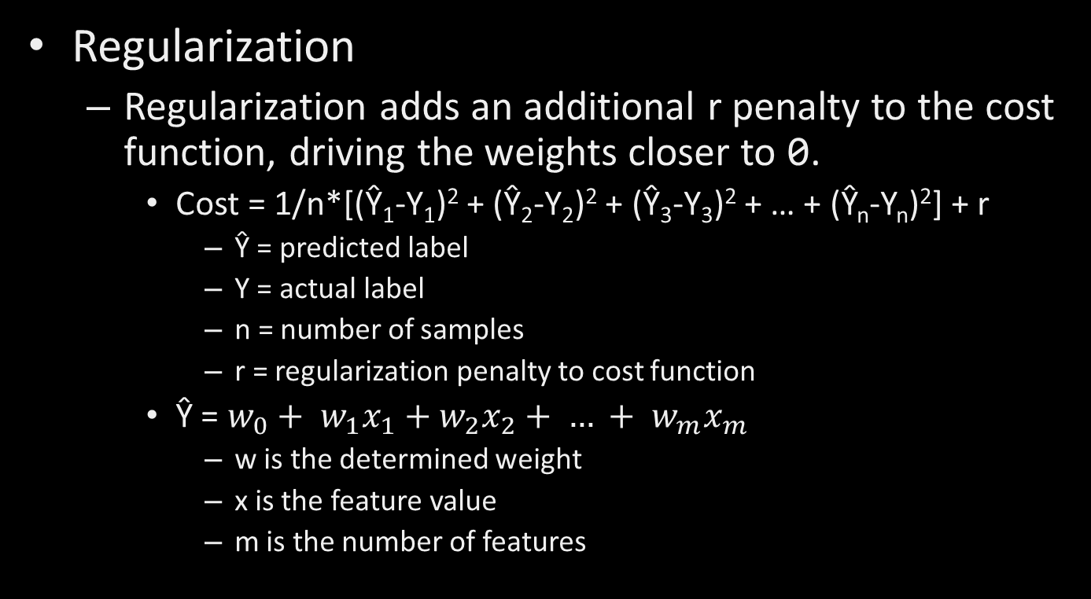
Linear Models - Classifiers
Regularization
Regularization adds an additional r penalty to the cost function, driving the weights closer to 0.
Cost = 1/n*[(Ŷ₁-Y₁)² + (Ŷ₂-Y₂)² + (Ŷ₃-Y₃)² + … + (Ŷ_{n}-Y_{n})²] + r
Ŷ = predicted label
Y = actual label
n = number of samples
r = regularization penalty to cost function
$\text{Ŷ} \text{= }w_{0}+ w_{1}x_{1}+w_{2}x_{2}+ … + w_{m}x_{m}$
w is the determined weight
x is the feature value
m is the number of features

Slide 65

Linear Models - Classifiers
Regularization
Alternative notation
J = $\frac{1}{n}\sum_{i=1}^{n}{{\left({\text{Ŷ}}_{i}−Y_{i}\right)}^{2}}$ + r
J = Cost Function
Ŷ = predicted label
Y = actual label
n = number of samples
r = regularization penalty to cost function
i = Sample index parameter

Slide 66

Linear Models - Classifiers
Regularization
Alternative notation
$\text{Ŷ} \text{=}\frac{1}{m}\sum_{k=1}^{m}{\left(w_{k}x_{k}\right)+ w_{0}}$
Ŷ = Predicted label for the given sample
m = Number of features
w = Weight values
x = Feature values
k = Feature index parameter

Slide 67
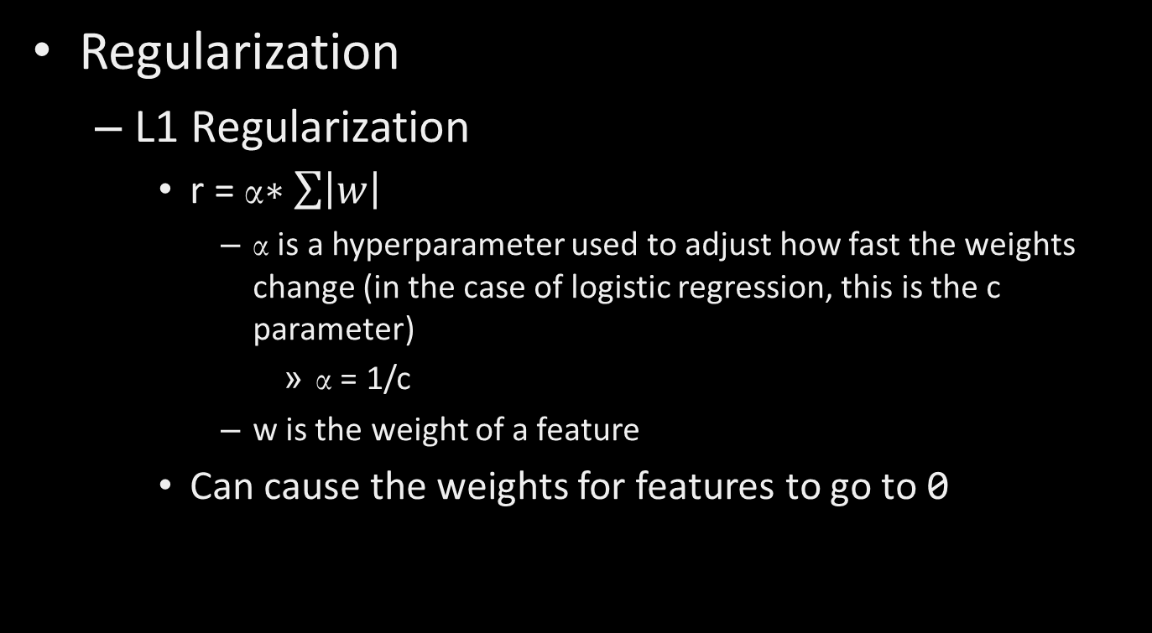
Linear Models - Classifiers
Regularization
L1 Regularization
r = α$∗\sum{\left|w\right|}$
α is a hyperparameter used to adjust how fast the weights change (in the case of logistic regression, this is the c parameter)
α = 1/c
w is the weight of a feature
Can cause the weights for features to go to 0

Slide 68
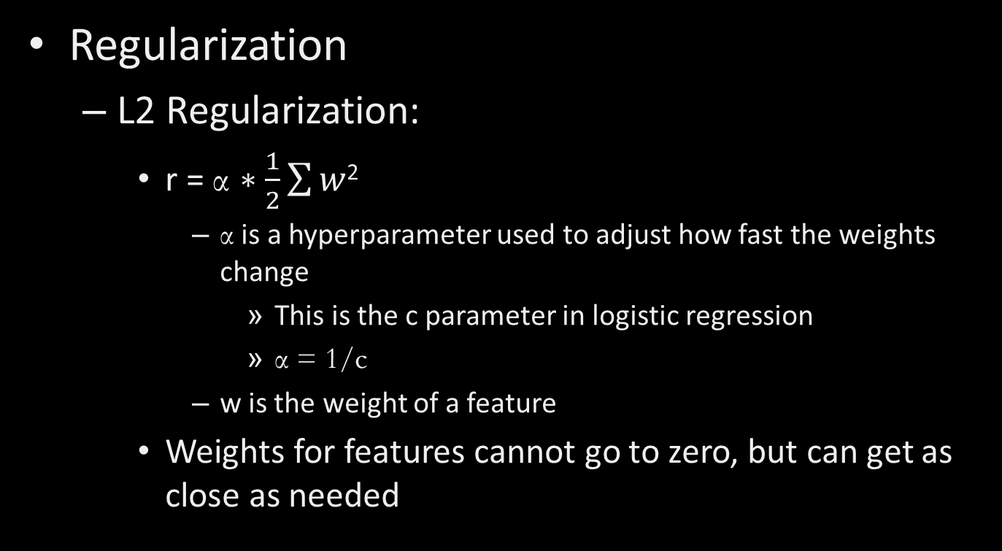
Linear Models - Classifiers
Regularization
L2 Regularization:
r = α $∗\frac{1}{2}\sum{w}$²
α is a hyperparameter used to adjust how fast the weights change
This is the c parameter in logistic regression
α = 1/c
w is the weight of a feature
Weights for features cannot go to zero, but can get as close as needed

Slide 69
Linear Models - Classifiers
Regularization
The general effect of regularization is to flatten a curve between all the data points.
Causes the model to better generalize to the data.

Slide 70
Linear Models - Classifiers
Support Vector Machine (SVM) Classifiers
Useful for small, complex datasets
Types
Linear
Create boundary line by maximizing distance between two classes.
Nonlinear
Use feature engineering to generate more features

Slide 71
Linear Models - Classifiers
Linear SVM
Attempts to create decision boundaries that maximize the space between the two closest samples.

Slide 72
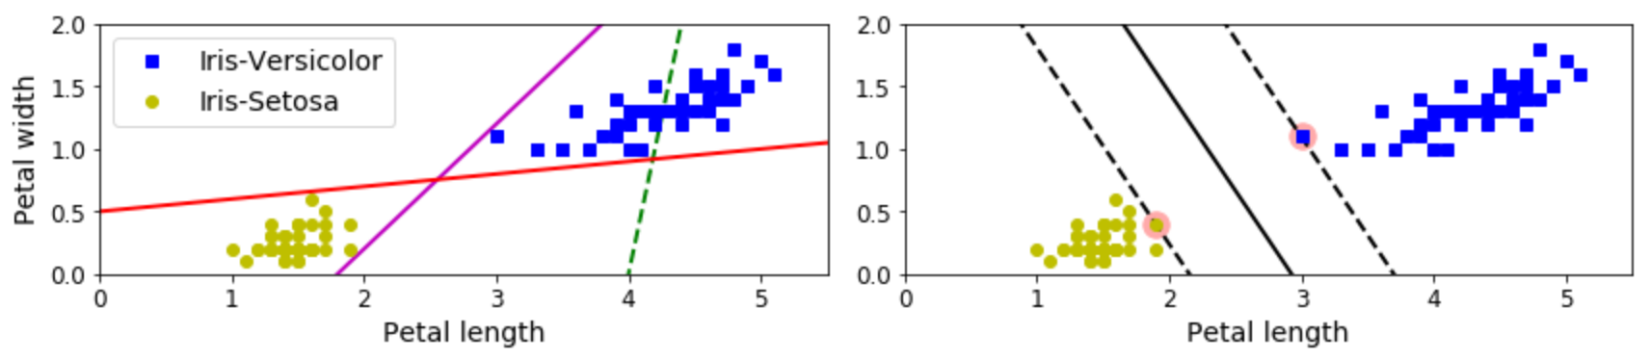
Linear Models - Classifiers
Linear SVM
The left figure below shows individual linear classifier boundaries for multiple models
The right figure shows the boundary for a linear SVM.
(4)

Slide 73
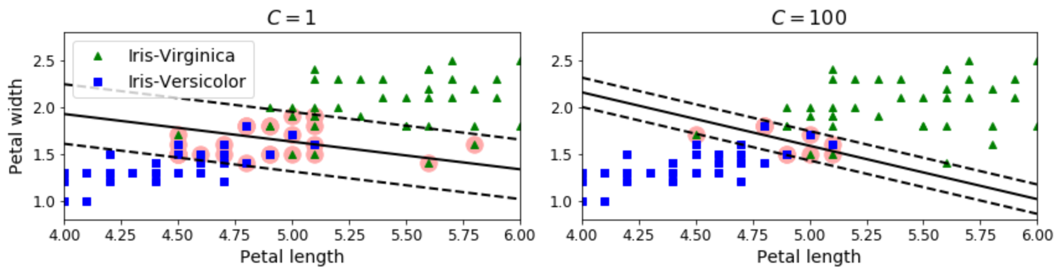
Linear Models - Classifiers
Linear SVM
Support Vectors
The points that generate the margin lines.
Margin Violations
Data points that are within the margins (dashed lines), even if they are on the correct side of the boundary.
(4)

Slide 74
Linear Models - Classifiers
Linear SVM
Regularization
Linear SVM’s use the c hyperparameter
The c value changes the width of the margins from the boundary condition.
Smaller c values increase the margins, which generalizes more

Slide 75
Linear Models - Classifiers
Linear SVM
Regularization
Smaller c values
Increase the margins
More generalized
More margin violations
Larger c values
Smaller margins
Fewer margin violations
Less generalization
Higher chance of overfitting to training data

Slide 76
Linear Models - Classifiers
Linear SVM
Regularization
(4)

Slide 77
Linear Models - Classifiers
In-class Example
Linear SVM

Slide 78
Linear Models - Classifiers
In-Class Exercise
Use LinearSVM, adjusting C to see how this affects accuracy and generalization.

Slide 79
STOPPED HERE

Slide 80
Linear Models - Classifiers
Nonlinear SVM
Used when classes are not linearly separable.
Multiple ways to deal with this

Slide 81
Linear Models - Classifiers
Nonlinear SVM
Feature Addition
Adding more features can allow the data to be linearly separable.

Slide 82
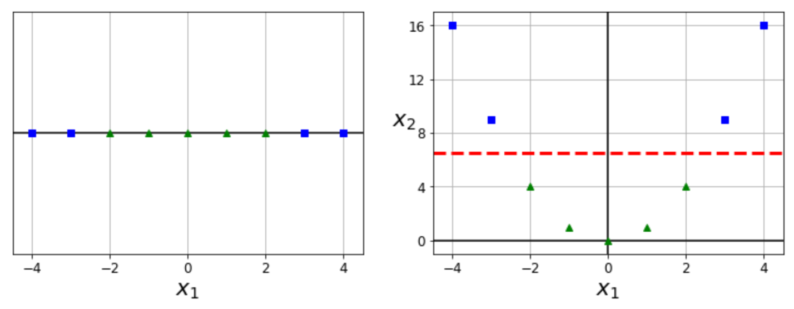
Linear Models - Classifiers
Nonlinear SVM
Feature Addition
The right figure results from creating a new parameter based on the squared value of the x₁ parameter.
(4)

Slide 83
Linear Models - Classifiers
Nonlinear SVM
Feature Addition
This new feature allows for a linearly separable boundary between the two classes.
(4)

Slide 84
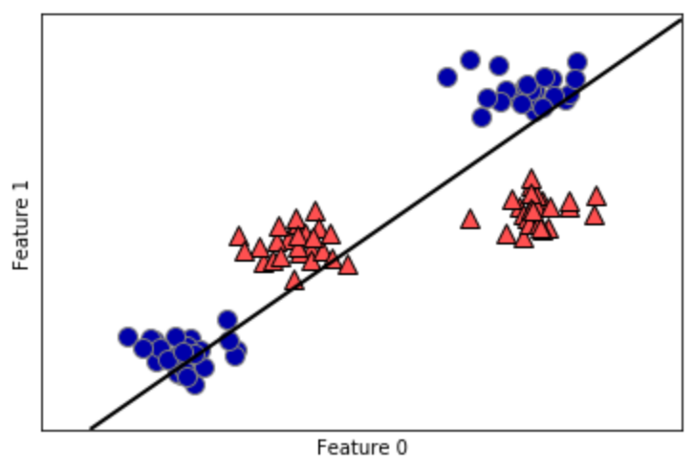
Linear Models - Classifiers
Nonlinear SVM
Feature addition transforms this (see reference 1):
(1)

Slide 85
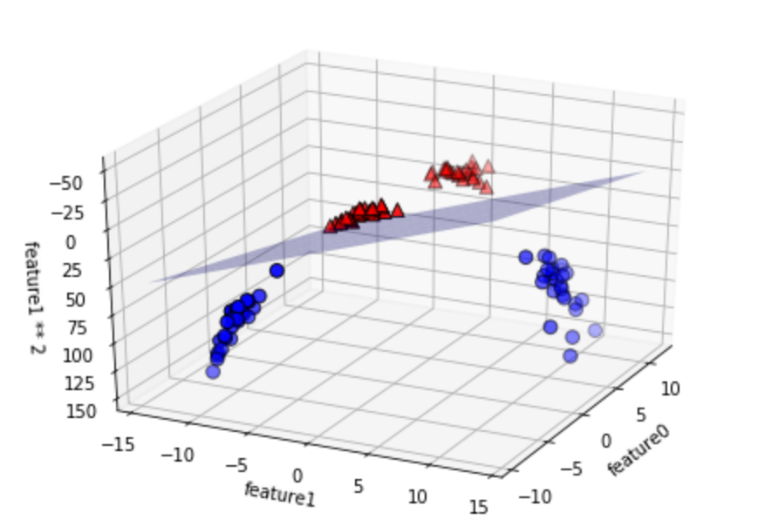
Linear Models - Classifiers
Nonlinear SVM
To this (see reference 1):
(1)
Notes:
It is almost like the previous slide is showing a projection of this graph along just the feauture1-feature0 plane.

Slide 86
Linear Models - Classifiers
Nonlinear SVM
Feature Addition
Methods:
Polynomial
Similarity Function

Slide 87
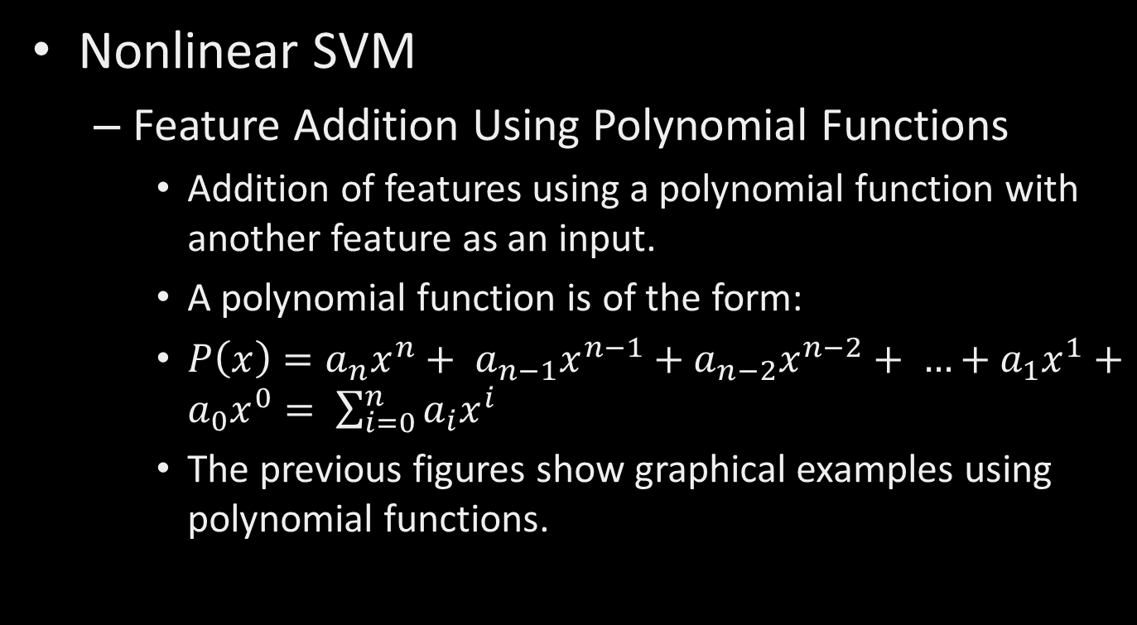
Linear Models - Classifiers
Nonlinear SVM
Feature Addition Using Polynomial Functions
Addition of features using a polynomial function with another feature as an input.
A polynomial function is of the form:
$P\left(x\right)={a_{n}x}^{n}+ {a_{n−1}x}^{n−1}+{a_{n−2}x}^{n−2}+ …+{a_{1}x}^{1}+{a_{0}x}^{0}= \sum_{i=0}^{n}{a_{i}x^{i}}$
The previous figures show graphical examples using polynomial functions.

Slide 88
Linear Models - Classifiers
Nonlinear SVM
Feature Addition using Similarity Function
A similarity function is used vs a polynomial function.
The similarity function measures how much each feature data point resembles a user-specified landmark.
The closer the data point is to a landmark, the higher the value from the similarity function.
Can select as many feature data points to be landmarks as desired, but this increases the amount of data to predict from.
The more landmarks chosen, the higher the linearity of the data since the number of dimensions increases.

Slide 89
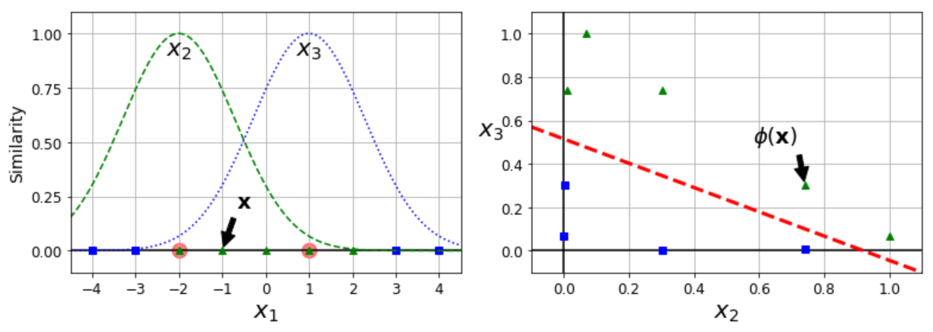
Linear Models - Classifiers
Nonlinear SVM
Feature Addition using Similarity Function
The following example uses the Gaussian Radial Basis Function as the similarity function, as an example.
(4)

Slide 90
Linear Models - Classifiers
Nonlinear SVM
Feature Addition using Similarity Function
The landmarks chosen here are -2 and 1.
(4)

Slide 91
Linear Models - Classifiers
Nonlinear SVM
gamma (γ) hyperparameter
Used for Gaussian RBF kernel
Causes width of bell curves to tighten
Causes decision boundary to wrap more tightly around the targeted class/landmarks.
Acts like the hyperparameter c
Higher values decrease generalization, and attempt to more exactly fit the data
Lower values increase generalization.

Slide 92
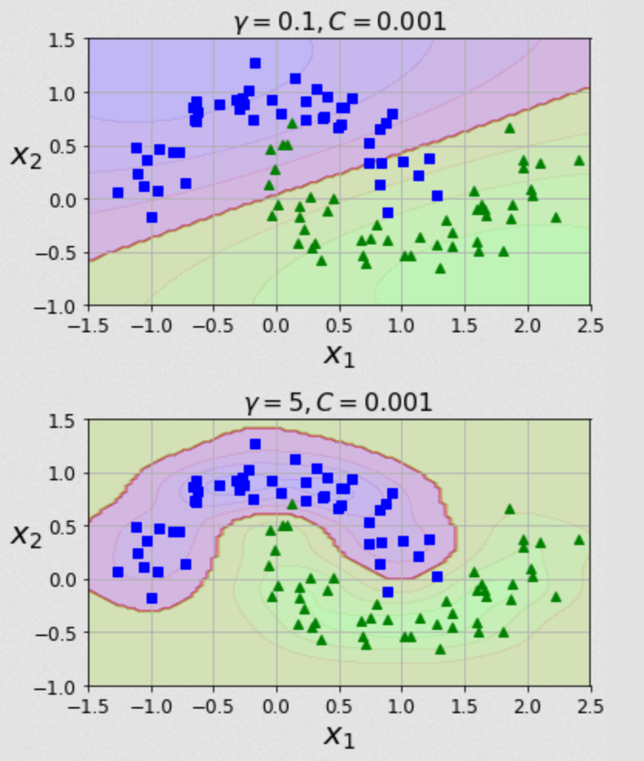
Linear Models - Classifiers
Nonlinear SVM
gamma (γ)
hyperparameter
(4)

Slide 93
Linear Models - Classifiers
Nonlinear SVM
Kernel Trick
Adding more features can allow the data to be linearly separable, but also increases the amount of computational power needed.
The kernel trick does some mathematical trickery to map the prediction function to a different space.
Mapping the function to a different space allows a less computationally expensive calculation vs computing values for the function itself.
This decreases the needed computational power.

Slide 94
Linear Models - Classifiers
Nonlinear SVM
Kernel Trick
Different kernels can be used, including for polynomial and similarity function methods covered above.
See code for examples.

Slide 95
Linear Models - Classifiers
In-class Example
Nonlinear SVM using feature addition
Nonlinear SVM using kernels

Slide 96
Linear Models - Classifiers
In-Class Exercise
Optimize the polynomial degree for nonlinear SVM using the polynomial kernel.
Use the RBF kernel with the nonlinear SVM, adjusting gamma and C to see how they affect accuracy and generalization.

Slide 97
Linear Models - Regressors
Regressors
Tries to predict as close to a value as possible.
Creates a linear equation to predict outcomes:
Y_{predict} = w₁*f₁ + w₂*f₂ + w₃*f₃ + … + w_{n}*f_{n} + b
Y_{predict} = predicted value for given sample
w = weights
f = feature value
b = intercept of linear line
n = number of features
A.k.a the prediction function.

Slide 98
Linear Models - Regressors
Regressors
The models we train adjust the values of w_{x} and b.
For functions with regularization, an additional term is added for model to optimize when generating prediction function
Examples:
Trying to predict median household income of an area.
Trying to predict the value a stock will rise to.

Slide 99
Linear Models - Regressors
K-Nearest Neighbors Regression
Similar to the classifier variant, the regressor picks the value that is closest to the most similar neighbor.
Multiple neighbors are averaged together.

Slide 100
Linear Models - Regressors
Linear Regression (Ordinary Least Squares)
Attempts to minimize the mean squared error between the prediction and the target values.
The error of this trainer is calculated by adding the squared differences between the predicted value with the actual target value.
No regularization parameters to adjust the accuracy of this trainer

Slide 101
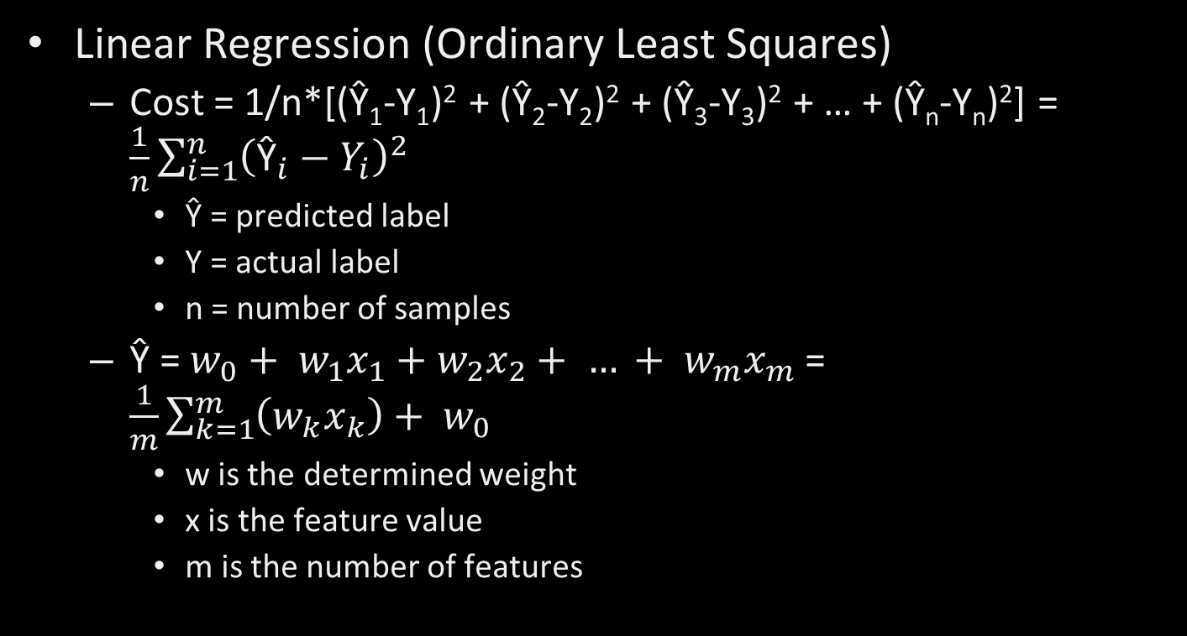
Linear Models - Regressors
Linear Regression (Ordinary Least Squares)
Cost = 1/n*[(Ŷ₁-Y₁)² + (Ŷ₂-Y₂)² + (Ŷ₃-Y₃)² + … + (Ŷ_{n}-Y_{n})²] = $\frac{1}{n}\sum_{i=1}^{n}{{\left({\text{Ŷ}}_{i}−Y_{i}\right)}^{2}}$
Ŷ = predicted label
Y = actual label
n = number of samples
$\text{Ŷ}\text{ = }w_{0}+ w_{1}x_{1}+w_{2}x_{2}+ … + w_{m}x_{m}$ = $\frac{1}{m}\sum_{k=1}^{m}{\left(w_{k}x_{k}\right)+ w_{0}}$
w is the determined weight
x is the feature value
m is the number of features

Slide 102
Linear Models - Regressors
In-Class Example – Linear Regression

Slide 103
Linear Models - Classifiers
In-Class Exercise
Run a linear regression prediction on the Boston housing data set.

Slide 104
Linear Models - Regressors
Ridge Regression
Uses Ordinary Least Squares as the cost function to fit the data
Adds additional constraint of attempting to minimize the magnitude of the weight coefficients for each feature without eliminating the feature.

Slide 105
Linear Models - Regressors
Ridge Regression
Each weight should be as close to zero as possible.
Each feature will have as little affect on the prediction as possible.
Note that the feature weights will not be exactly zero using this trainer, so each feature still affects the prediction.

Slide 106
Linear Models - Regressors
Ridge Regression
Attempting to minimize the weight magnitudes is a form of regularization.
Regularization is used to attempt to prevent overfitting.
This trainer uses L2 regularization
The sum of the square of the weight coefficient for each feature is used as a penalty term in determining model accuracy.

Slide 107
Linear Models - Regressors
Ridge Regression
For this Scikit-Learn trainer, alpha is the hyperparameter used for regularization.
Increasing alpha moves each feature’s weight more towards zero.
This may help make the model more generalized, which will help overfitting.
This will decrease training set performance.

Slide 108
Linear Models - Regressors
Ridge Regression
Increasing alpha more and more will not necessarily make the model more predictive.
Alpha will need tuned for an optimal model.

Slide 109
Linear Models - Regressors
In-Class Example – Ridge Regression

Slide 110
Linear Models - Regressors
In-Class Exercise
Run the example with ridge regression, attempting to optimize the test prediction data set by adjusting alpha.

Slide 111
Linear Models - Regressors
LASSO Regression
Least Absolute Shrinkage and Selection Operator
Similar to ridge regression, uses a modified Ordinary Least Squares algorithm as the cost function.
Attempts to make each weight close to zero.
In this trainer, a weight value can be zero, so that a feature will not affect the prediction.

Slide 112
Linear Models - Regressors
LASSO Regression
This trainer uses L1 regularization.
The sum of the weight coefficient for each feature is used as a penalty term in determining model accuracy.
Alpha is the hyperparameter used for regularization.

Slide 113
Linear Models - Regressors
In-Class Example – LASSO Regression

Slide 114
Linear Models - Regressors
In-Class Exercise
Generate models for the boston housing data using linear, ridge, and LASSO regressors. For models that use regularization, attempt to optimize the predictions (can use previous example code).
Which model is the most accurate with respect to test data predictions? Are there benefits to the models that are less accurate?

Slide 115
Linear Models - Regressors
Decision Tree
Works similar to classifier, except mean squared error is used in cost function to determine boundaries.
Each node has a predicted value that is the average of all values within its decision boundary.

Slide 116
Linear Models - Regressors
Decision Tree
The same pros and cons exist as the classifier variant of the decision tree.

Slide 117
Linear Models - Regressors
In-Class Exercise
Run the decision tree regressor example. As with the classifier example, play with the depth to see how accuracy is affected.

Slide 118
Dataset Preparation
Overview
Train Test Split
Cross Validation
Scaling Data
Converting Categories to Numbers
Checking Feature Correlation
Manually Engineering Features

Slide 119
Dataset Preparation
Converting Categories to Numbers
Trainers understand numbers better than text. If there are a set number of text categories, converting them to numbers will help.
If you have 5 categories, replacing them with numbers will make the model better.
‘Lake’ → 0
‘River’ → 1
‘Stream’ → 2
‘Ocean’ → 3
‘Pond’ → 4

Slide 120
Dataset Preparation
Converting Categories to Numbers
Trainers usually assume that numbers closer together are closer related. If this is not the case, then creating a new column with the category as the feature name will increase the models predictive ability.

Slide 121
Dataset Preparation
Converting Categories to Numbers
i.e. In the previous example, a lake and a pond are more closely related than a lake and a river, but the river is numerically closer to the lake.
Would be better to create a new column for each category, and use either 0 or 1 to tell whether the feature applies to the sample or not.
This is called one-hot encoding.
Can use sklearn.preprocessing.LabelBinarizer class to automatically do this.

Slide 122
Dataset Preparation
Checking Feature Correlation
Use the .corr method of a pandas dataframe
Ranges from [-1,1]
Closer to 0 means the feature has less affect.
Closer to 1 means increasing the feature increases the prediction, decreasing the feature decreases the prediction.
Closer to -1 means increasing the feature decreases the prediction value, and vice versa.

Slide 123
Dataset Preparation
Checking Feature Correlation
scipy Correlation Functions
Pearson’s R Correlation
For linear correlations
scipy.stats.pearsonr(iterable_1, iterable_2)
Will not show non-linear correlations

Slide 124
Dataset Preparation
Checking Feature Correlation
scipy Correlation Functions
Spearman’s Correlation
For non-linear correlations
scipy.stats.spearmanr(iterable_1, iterable_2)
Will also show linear correlations, but the magnitude will not be as high as with Pearson’s

Slide 125
Dataset Preparation
Manually Engineering Features
Just like with SVM, can create new features from existing features.
For instance, in housing data, maybe number of rooms and number of bedrooms is given. Maybe the number of bedrooms/number of rooms will be a better feature.
Use correlation coefficients to determine if the new features are useful or not.

Slide 126
Dataset Preparation
In-Class Exercise
Start with creating a basic LinearRegressor model, and train it using train_test_split. Get and store the initial accuracy values for the test set and training set.

Slide 127
Dataset Preparation
In-Class Exercise
Apply each of the following steps, checking the accuracy after each step is applied:
Cross validation instead of train test split
Scale the data
Converting any string categories to numbers
Remove weak features using correlation coefficients
Manually engineer some new features, checking their effectiveness using correlation coefficients.

Slide 128
Evaluating Accuracy of Classifiers
Overview
Why accuracy isn’t enough
Precision = TP/(TP+FP)
Recall (True Positive Rate, Sensitivity)
False Positive Rate
Specificity (True Negative Rate)
Confusion Matrix
Accuracy

Slide 129
Evaluating Accuracy of Classifiers
Overview
Precision Recall Curves
precision_recall_curve()
Receiver Operating Characteristics (ROC) Curve
roc_curve()
Area Under the Curve (AUC)
roc_auc_score()
Mean Squared Error
mse

Slide 130
Evaluating Accuracy of Classifiers
Why accuracy alone isn’t enough
Skewed datasets
If the dataset contains many more targets of one classification vs another, it is very easy to get high accuracy by just guessing the most likely class.

Slide 131
Evaluating Accuracy of Classifiers
Why accuracy alone isn’t enough
High importance of not getting false positives or false negatives
Predicting a false negative for something like cancer recognition is much less preferred than predicting a false positive.
i.e. we would rather have the model incorrectly predict a benign tumor is malignant vs predict a malignant tumor benign.

Slide 132
Evaluating Accuracy of Classifiers
Except for mean squared error, all of these methods apply to classification trainers and models.

Slide 133
Evaluating Accuracy of Classifiers
Precision
TP/(TP+FP)
Can achieve 100% if a single prediction is made and it is correct.
Must look at other metrics.

Slide 134
Evaluating Accuracy of Classifiers
Recall
TP/(TP+FN)
A.k.a. True Positive Rate
A.k.a. Sensitivity

Slide 135
Evaluating Accuracy of Classifiers
False Positive Rate
FP/(TP+FN) = 1-TNR

Slide 136
Evaluating Accuracy of Classifiers
True Negative Rate
TN/(TN+FP) = 1-FNR

Slide 137
Evaluating Accuracy of Classifiers
Increasing precision decreases recall, and vice versa.

Slide 138
Evaluating Accuracy of Classifiers
Confusion Matrix
2-dimensional data table
Measure of how “confused” our model is.
Each cell shows how many classifications were predicted, and what the actual target was.
Rows are actual targets
Columns are predicted targets

Slide 139
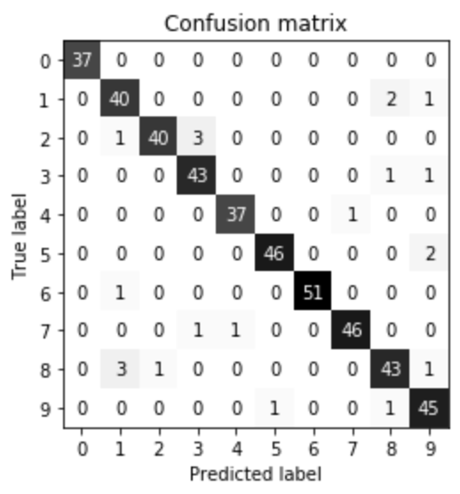
Evaluating Accuracy of Classifiers
Confusion Matrix
Example

Slide 140
Evaluating Accuracy of Classifiers
Accuracy
(TP + TN)/(TP + TN + FP + FN)

Slide 141
Evaluating Accuracy of Classifiers
Precision Recall Curves

Slide 142
Evaluating Accuracy of Classifiers
Receiver Operating Characteristics (ROC) Curve
Plots True Positive Rate vs False Positive Rate

Slide 143
Evaluating Accuracy of Classifiers
Area Under the Curve (AUC)

Slide 144

Evaluating Accuracy of Regressors
Overview
Mean Squared Error
Coefficient of Determination ($r^{2}$)
Residuals Plot
Prediction Error Plot

Slide 145
Evaluating Accuracy of Regressors
Mean Squared Error

Slide 146

Evaluating Accuracy of Regressors
Coefficient of Determination ($r^{2}$)

Slide 147
Evaluating Accuracy of Regressors
Residuals Plot

Slide 148
Evaluating Accuracy of Regressors
Prediction Error Plot

Slide 149
Ensemble Methods
Overview
Voting Classifiers
Bagging and Pasting
Random Forests
Boosting
Stacking

Slide 150
Ensemble Methods
Overview
It is important to choose very different algorithms for each trainer. This will prevent any single type of error from growing too large, and will allow each error to be voted out from the other trainers.

Slide 151
Ensemble Methods
Voting Classifiers
Train multiple different classifiers.
Using the VotingClassifier, have each classifier vote on what the predicted label should be.

Slide 152
Ensemble Methods
Voting Classifiers
Hard vs Soft Voting
Hard is a simple vote
Soft voting calculates the class probabilities from each model, averages them over all individual models. The highest probability is the estimated class.
Requires trainers that have the predict_proba() method.

Slide 153
Ensemble Methods
Bagging and Pasting

Slide 154
Ensemble Methods
Random Forests
Decision trees tend to overfit
Use multiple, slightly different models to increase predictive capability.
Can be used for either classifiers or regressors.

Slide 155
Ensemble Methods
Boosting

Slide 156
Ensemble Methods
Stacking

Slide 157
Tuning
Determining what features matter
If both prediction test scores and training scores are low, then the model is suffering from underfitting.
If the model has extremely high training scores, but not nearly as high prediction test scores, the model is suffering from overfitting.

Slide 158
Tuning
Grid Search

Slide 159
Tuning
Parameters to Play with
K-Nearest Neighbors
Number of neighbors to test point
Algorithm to evaluate distance test point is from data points

Slide 160
Tuning
Parameters to Play with
Decision Trees
max_depth
max_leaf_nodes
max_features
min_samples_split
min_samples_leaf
min_weight_fraction_leaf

Slide 161
Tuning
Parameters to Play with
alpha
Higher values increase regularization/generalization
Higher value pushes feature weights closer to zero
Lasso Regression
Ridge Regression

Slide 162
Tuning
Parameters to Play with
c
Lower values increase generalization
Higher value causes algorithm to attempt to fit each training data point as best as possible
Logistic regression
Linear support vector machine

Slide 163
Tuning
Parameters to Play with
gamma
Lower values increase generalization, reducing overfitting.
Higher value causes algorithm to attempt to fit each training data point as best as possible, reducing generalization.
Linear support vector machine

Slide 164
Tuning
Parameters to Play with
c and alpha are known as hyperparameters.
Hyperparameters are parameters that are set before a model is trained, and stays constant throughout the learning process.

Slide 165

Bibliography
https://github.com/amueller/introduction_to_ml_with_python/blob/master/02-supervised-learning.ipynb
Müller, A. C., & Guido, S. (2016). Introduction to Machine Learning with Python: A Guide for Data Scientists (1st ed.). O’Reilly Media.
http://rasbt.github.io/mlxtend/user_guide/general_concepts/gradient-optimization/

Slide 166
Bibliography
https://github.com/ageron/handson-ml
Géron Aurélien. Hands-on Machine Learning with Scikit-Learn and Tensorflow. 1st ed., O'Reilly, 2017.
https://machinelearningmastery.com/how-to-use-correlation-to-understand-the-relationship-between-variables/

Slide 167
Bibliography
Harrison, Matt. Machine Learning Pocket Reference: Working with Structured Data in Python. 1st ed., O'Reilly, 2019.

Slide 168
Additional Resources
https://towardsdatascience.com/over-fitting-and-regularization-64d16100f45c

Slide 169
LICENSE
Copyright 2021 Douglas Bowman
Permission is hereby granted, free of charge, to any person obtaining a copy of this software and associated documentation files (the "Software"), to deal in the Software without restriction, including without limitation the rights to use, copy, modify, merge, publish, distribute, sublicense, and/or sell copies of the Software, and to permit persons to whom the Software is furnished to do so, subject to the following conditions:
The above copyright notice and this permission notice shall be included in all copies or substantial portions of the Software.
THE SOFTWARE IS PROVIDED "AS IS", WITHOUT WARRANTY OF ANY KIND, EXPRESS OR IMPLIED, INCLUDING BUT NOT LIMITED TO THE WARRANTIES OF MERCHANTABILITY, FITNESS FOR A PARTICULAR PURPOSE AND NONINFRINGEMENT. IN NO EVENT SHALL THE AUTHORS OR COPYRIGHT HOLDERS BE LIABLE FOR ANY CLAIM, DAMAGES OR OTHER LIABILITY, WHETHER IN AN ACTION OF CONTRACT, TORT OR OTHERWISE, ARISING FROM, OUT OF OR IN CONNECTION WITH THE SOFTWARE OR THE USE OR OTHER DEALINGS IN THE SOFTWARE.

